Slide 1
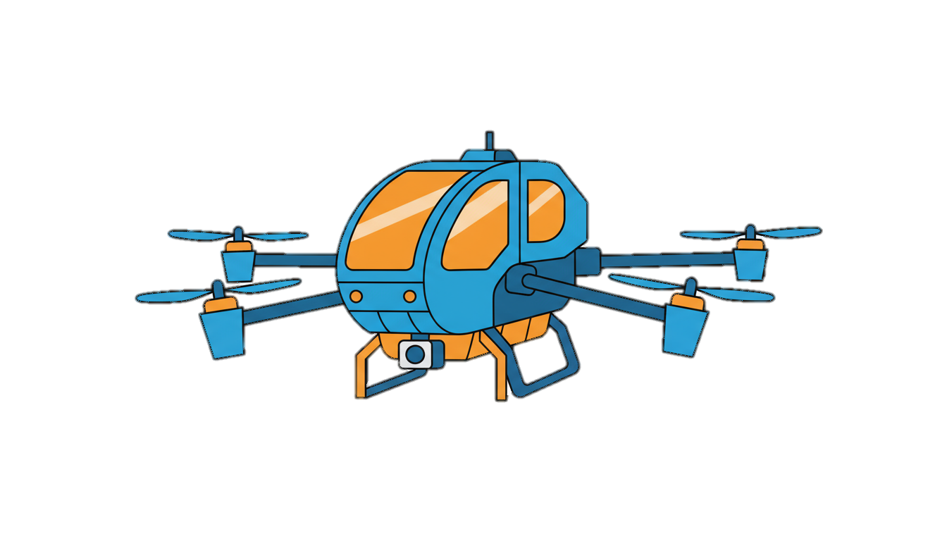
Air-Driven UAV Collision & Intrusion Detection System
Team Name: SkyGuard AI
Member: Rakesh Babu Gajula (Solo Participant)
Theme: Flight of the Future (Aerospace / UAVs)
Air traffic management, drone/UAV control

Slide 2
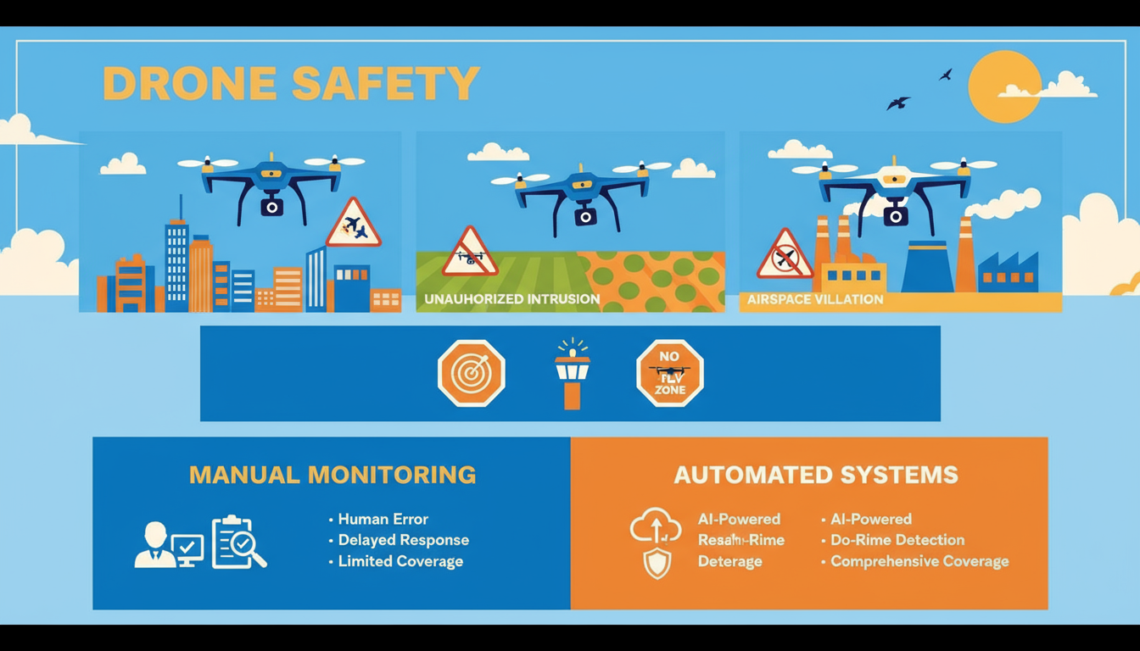
Problem Statement
🧐 Rapid growth in UAV/drone usage across Industries
🧐 Increasing risks of:
Mid-air collisions
Unauthorized drone intrusions
Airspace violations near airports, defence zones
🧐 Lack of affordable & real-time safety systems
🧐 Manual monitoring is inefficient and prone to delay

Slide 3
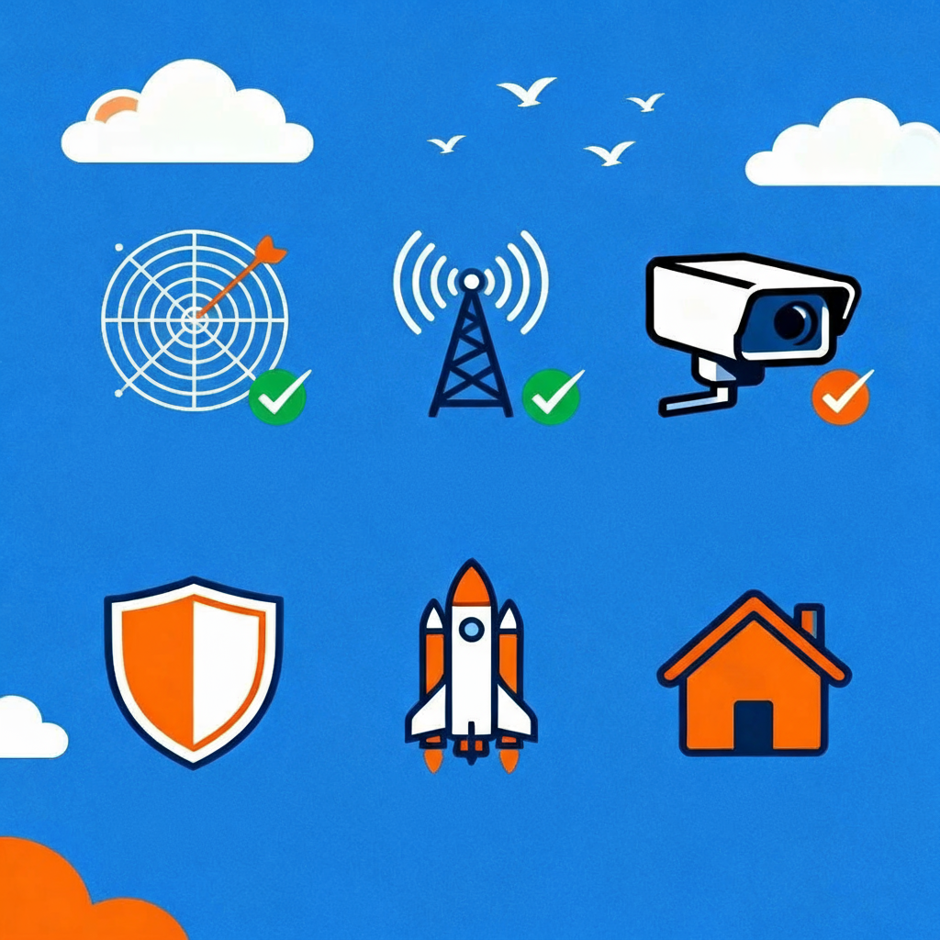
Project Objective
To develop a lightweight, AI-based system that can:
✅Predict UAV collisions in advance
✅Detect intrusions using real-time video feeds
✅Provide alerts with minimal infrastructure
✅Work in defence, aerospace, and civilian zones

Slide 4
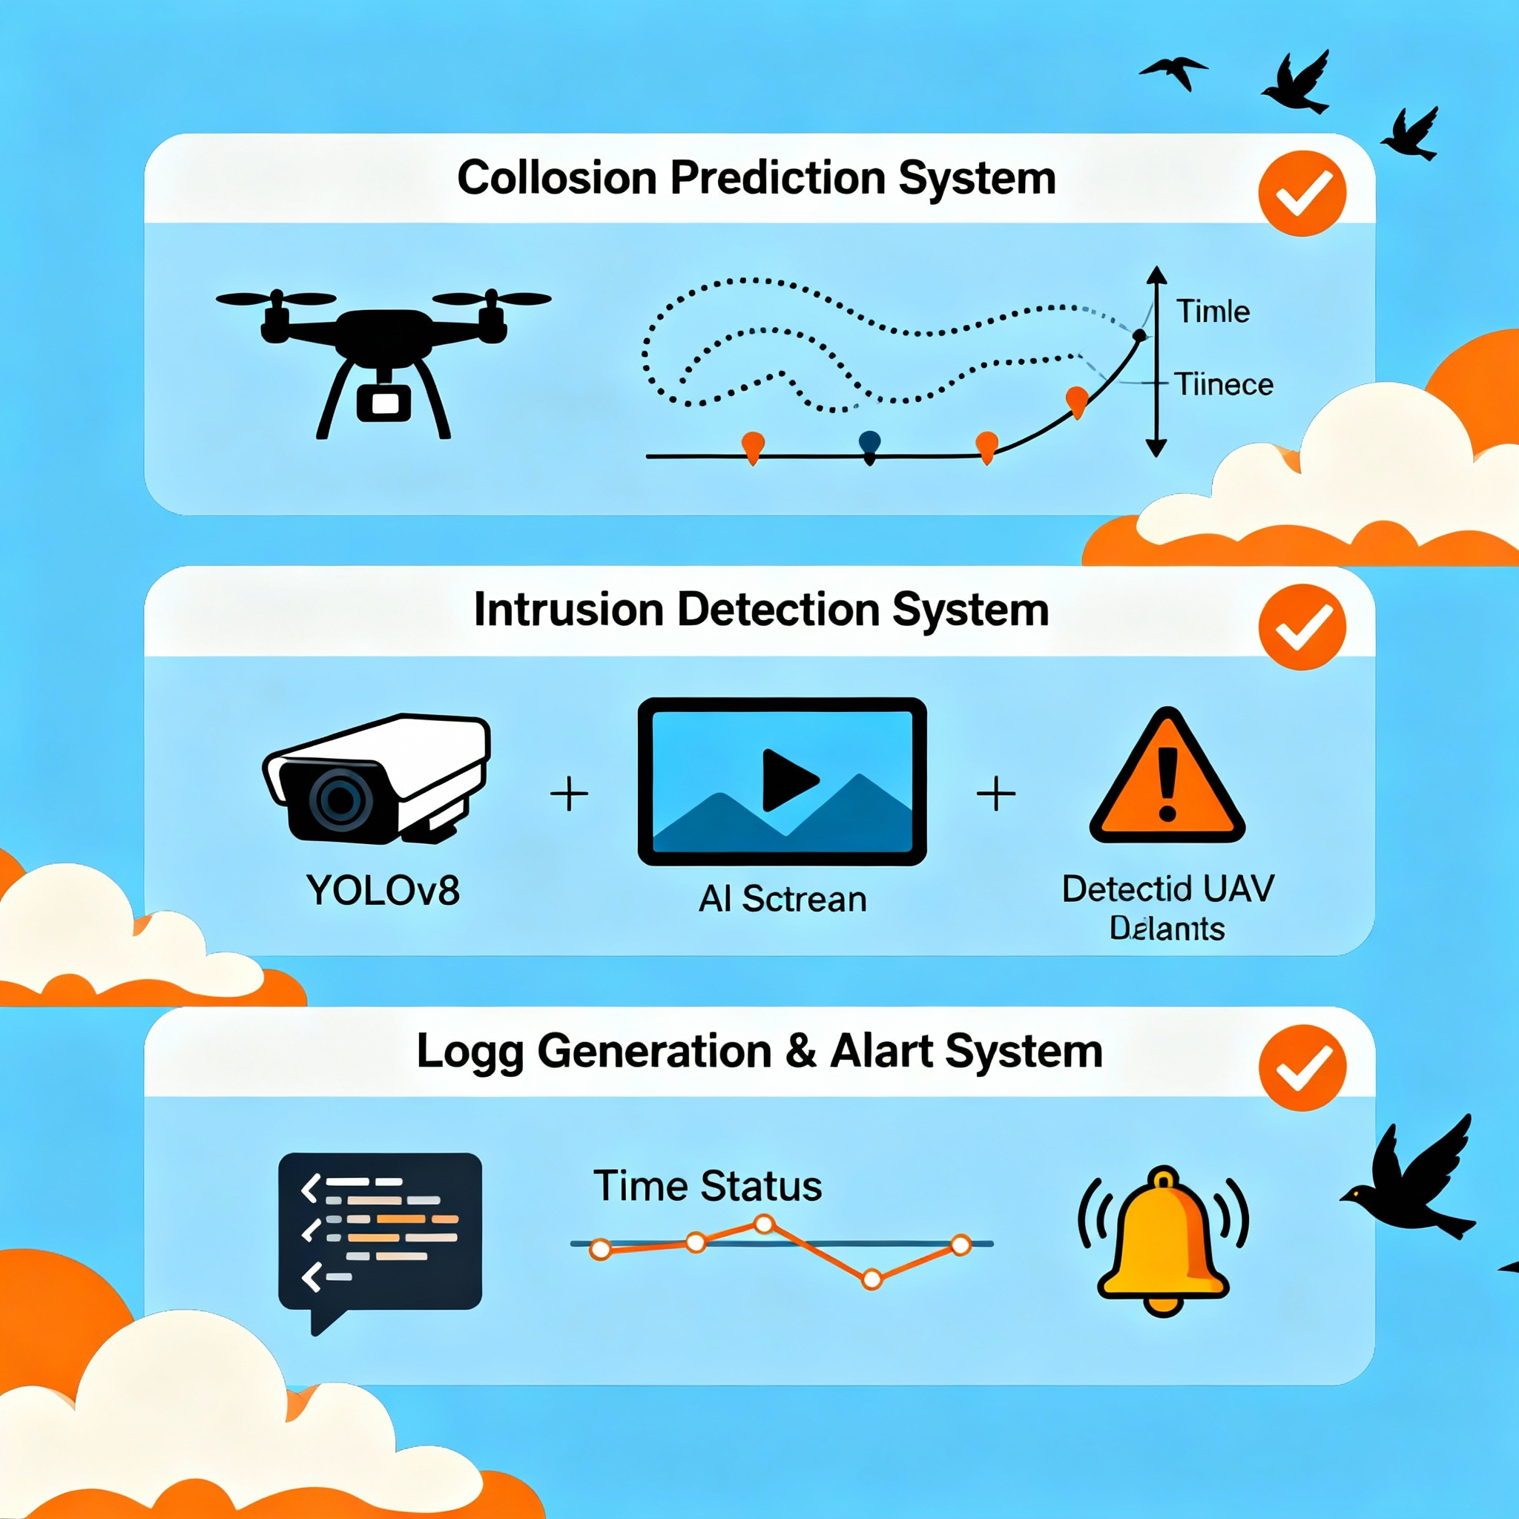
Key Features
✔ Collision Prediction System
Simulated drone paths
Distance calculation over time
Safe threshold alerts
✔ Intrusion Detection System
AI vision (YOLOv8)
Monitors video streams
Detects unauthorized UAV objects
✔ Log Generation & Alert System
JSON-based logs
Real-time status tracking

Slide 5

Technology Stack
Programming: Python
AI/Detection: YOLOv8, OpenCV
Simulation: CSV-based synthetic flight paths
Visualization : Streamlit
Data Handling: Pandas, NumPy
Plotting: Matplotlib
Config: JSON-based settings
Deployment: Local system

Slide 6
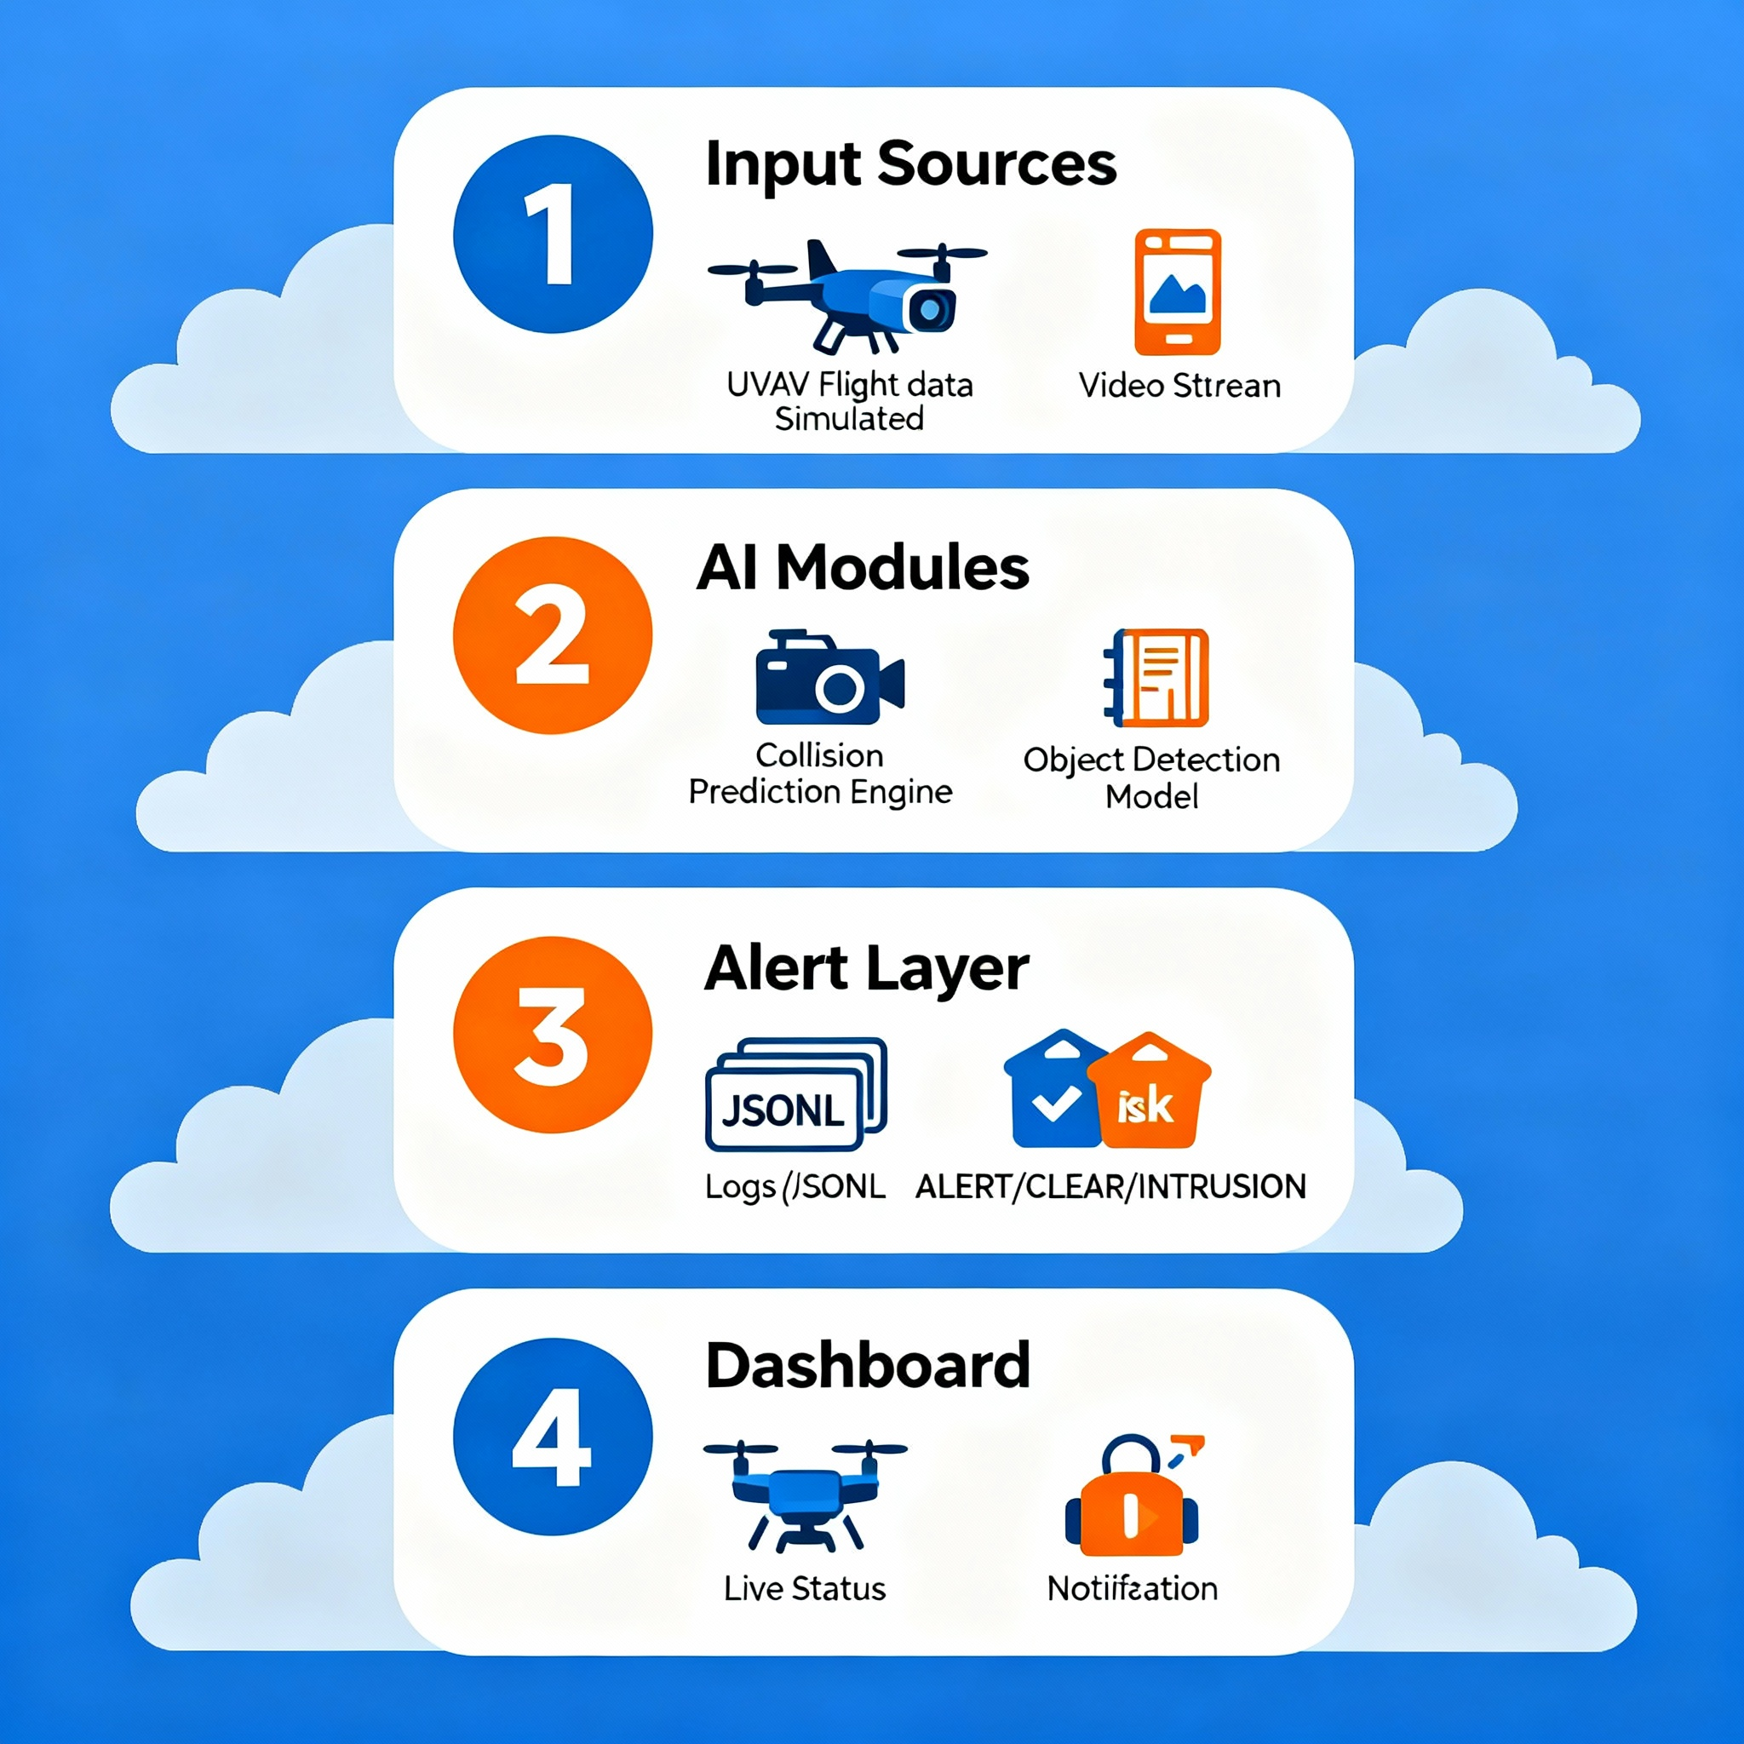
System Architecture
1️⃣ Input Sources
UAV flight data (simulated)
Video stream (camera/file)
2️⃣ AI Modules
Collision prediction engine
Object detection model
3️⃣ Alert Layer
Logs (JSONL)
Risk tags: ALERT / CLEAR / INTRUSION
4️⃣ Dashboard
Live status & notifications

Slide 7
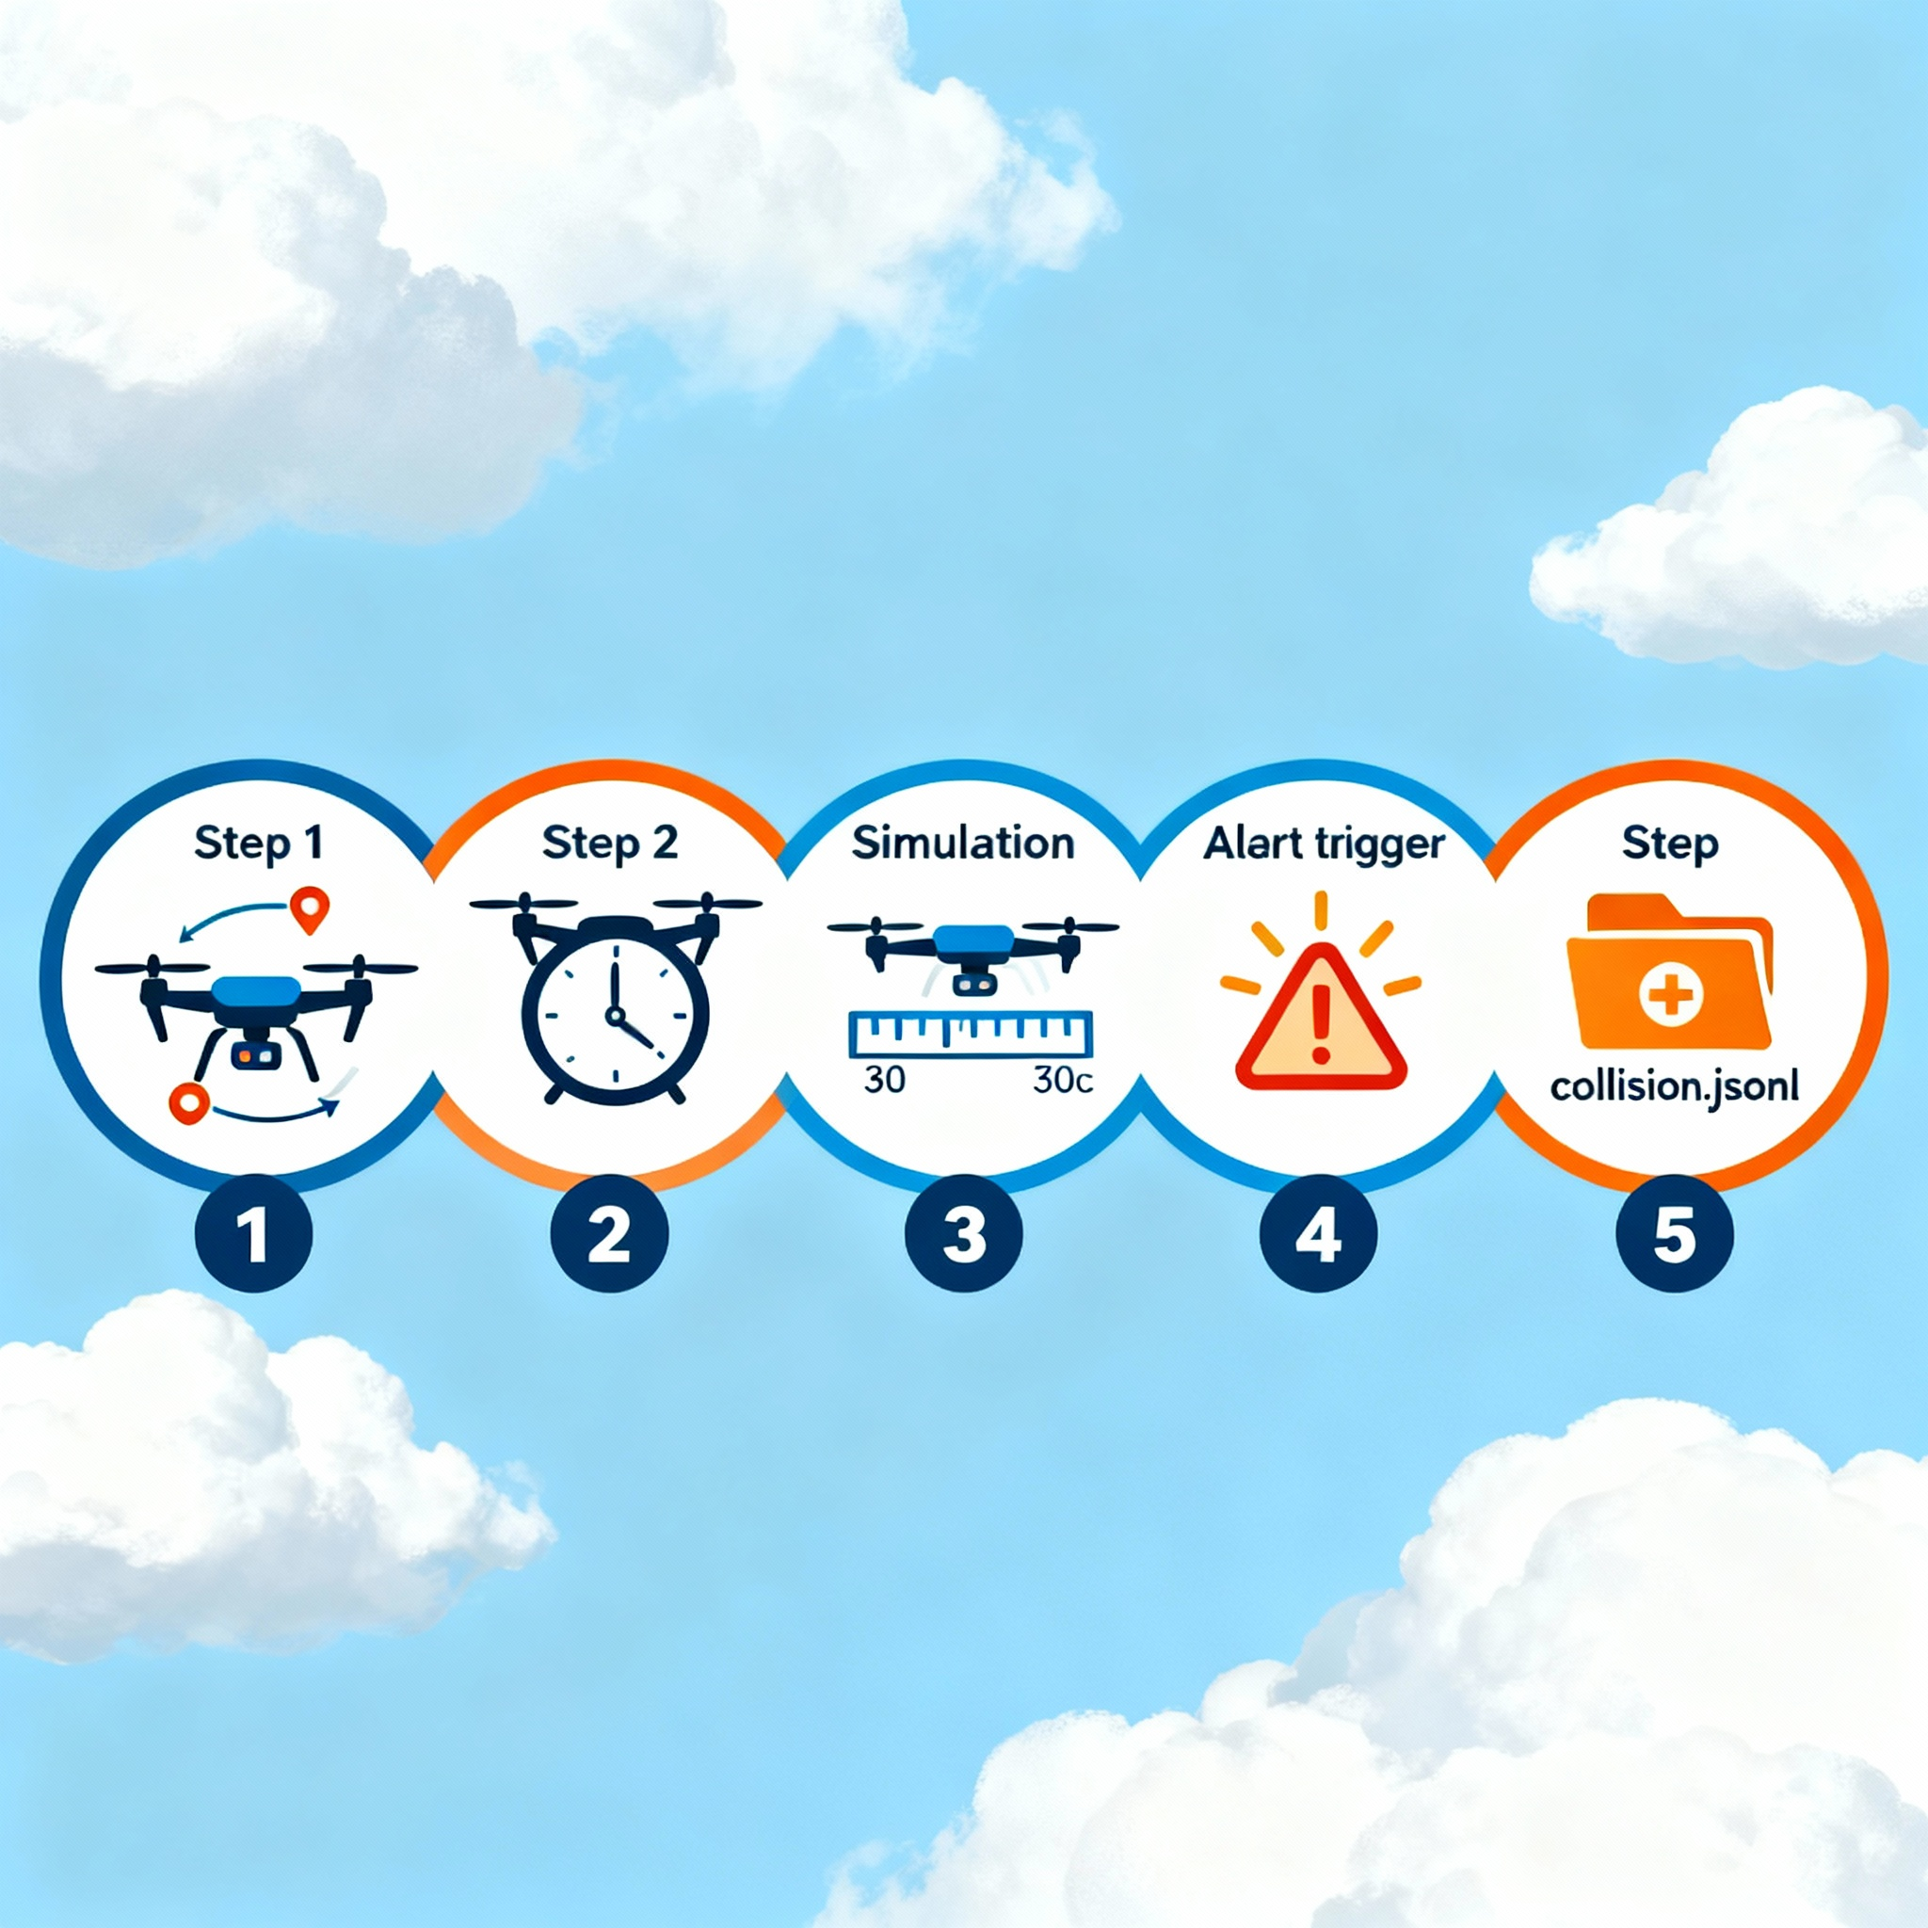
Collision Prediction
💥 Take positions & velocities of two UAVs
💥 Simulate movement for next 30 seconds
💥 Calculate minimum distance
💥 If below safe threshold → Trigger ALERT
💥 Output saved in: logs/collision.jsonl
Example Output:
time: 12.5s
min_distance: 5.7m
risk: ALERT

Slide 8
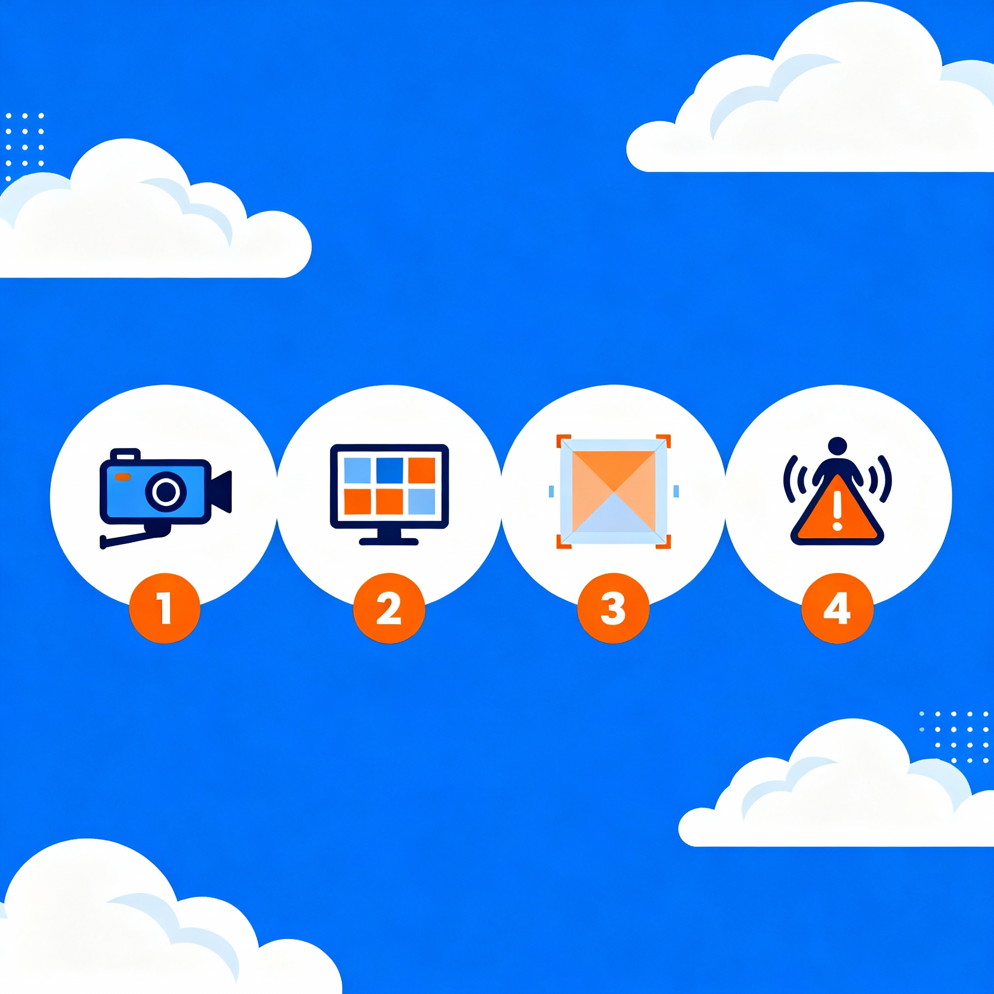
Intrusion Detection
🚨Pre-trained YOLOv8 model used
🚨Video feed processed frame-by-frame
🚨Region of interest (ROI) defined
🚨Any object inside ROI → “Intrusion”
Example Logged Result:
t = 3.8s
detections_in_roi = 1
status = INTRUSION
Output file: logs/intrusion.jsonl

Slide 9
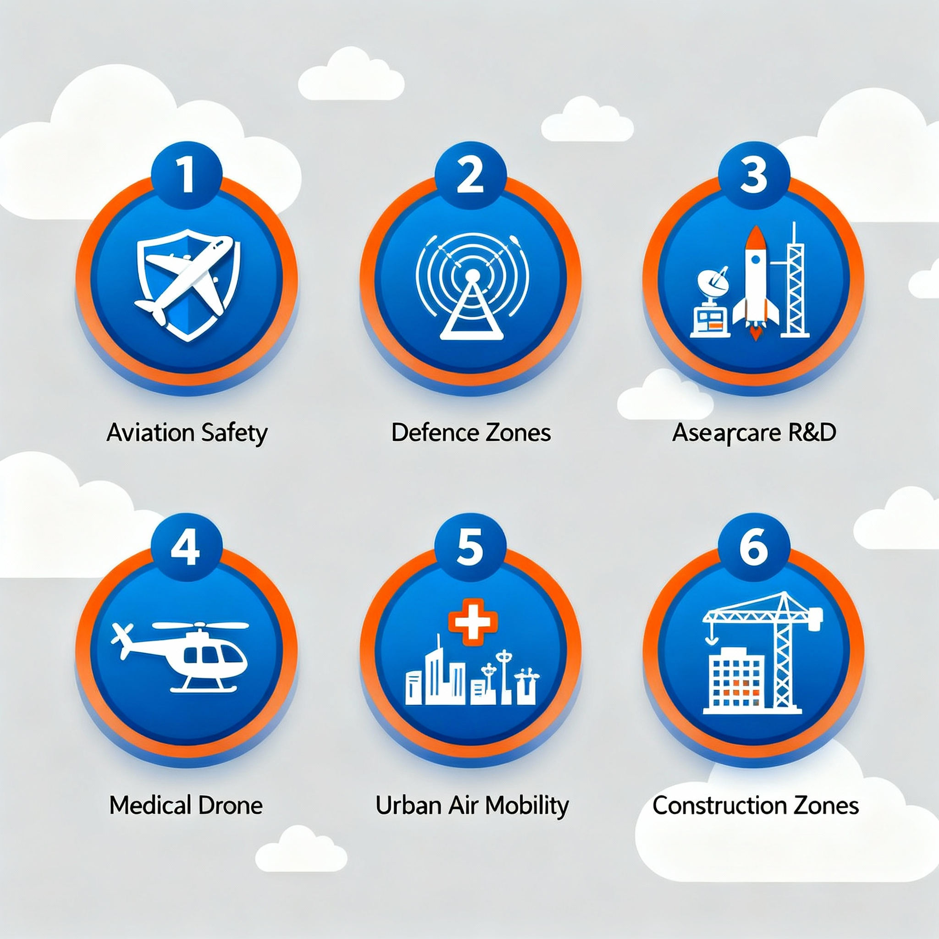
Use Cases
✈Aviation Safety – Drone traffic coordination
🛡Defence Zones – Secure airspace monitoring
🛰Aerospace R&D – Smart UAV operations
🏥Medical Drones – Collision-free travel
🌇Urban Air Mobility – Drone taxis, delivery
🏗 Construction zones – Perimeter surveillance

Slide 10
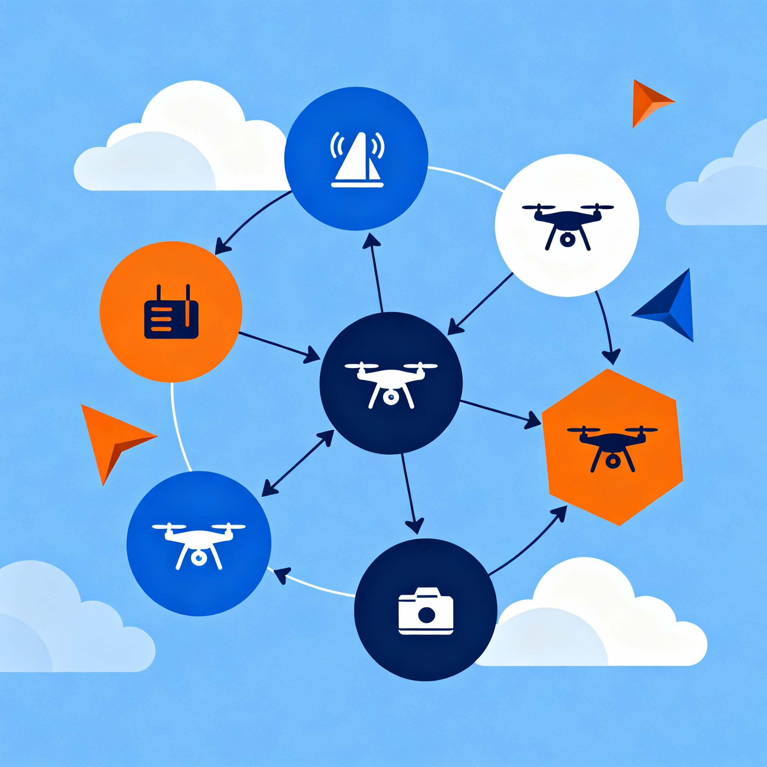
Innovation & Advantages
💡Works without expensive hardware 💡AI-based safety for UAV systems 💡Scalable for multiple drones
💡Customizable thresholds & zones 💡Defence and aerospace ready 💡Solo-developer friendly build

Slide 11
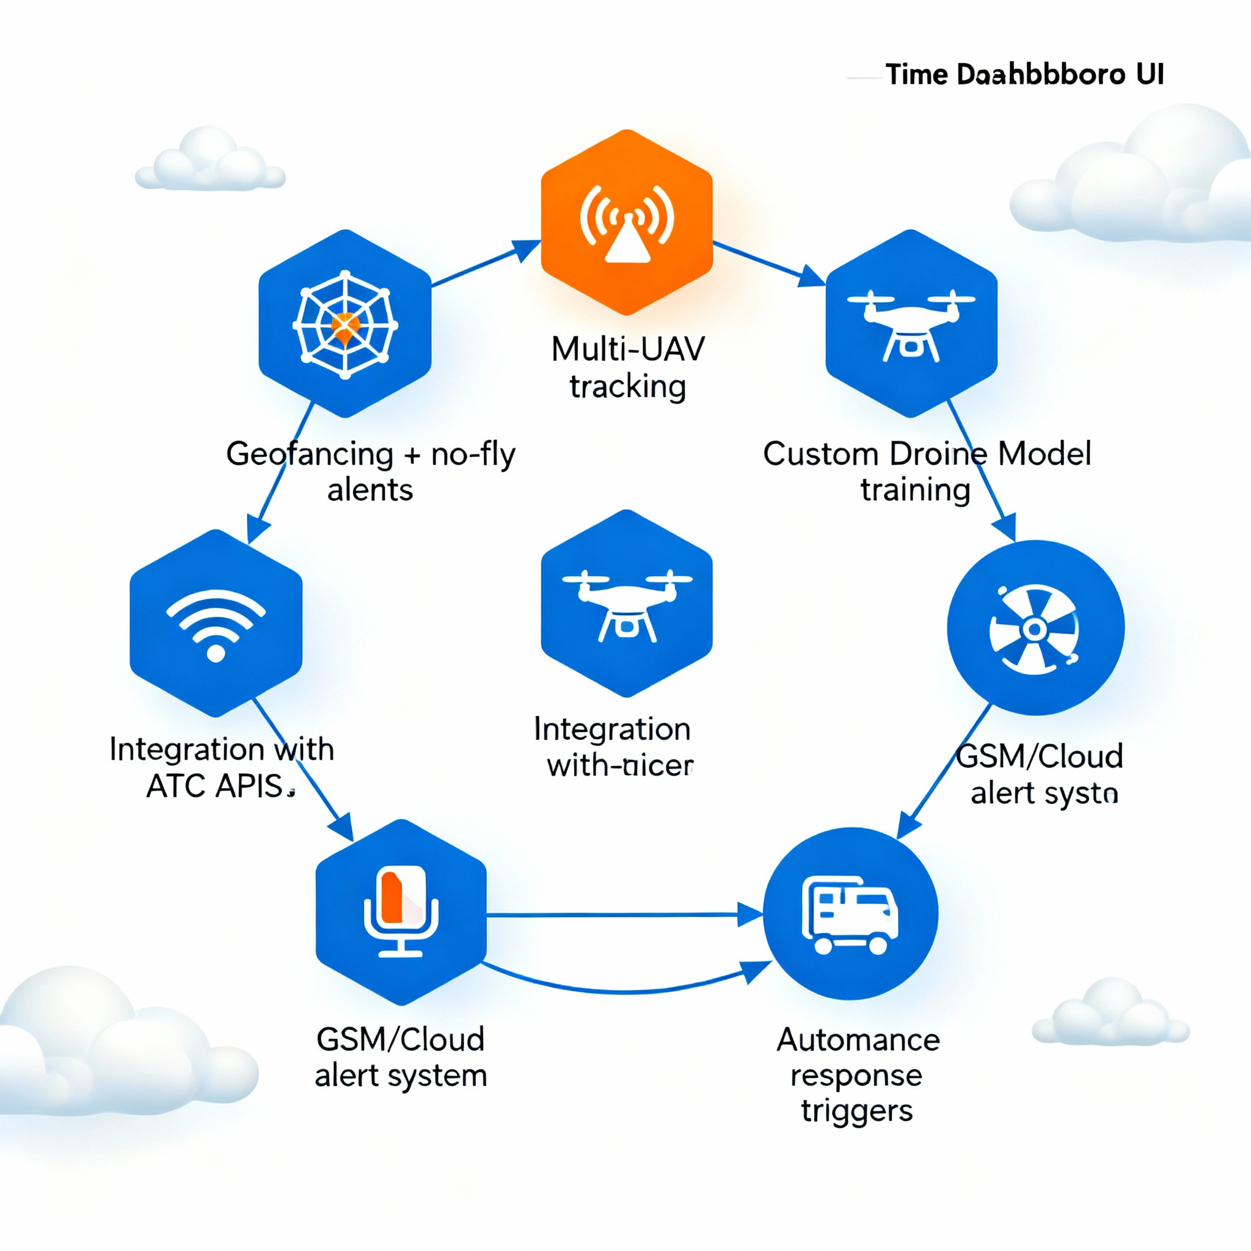
Future Enhancements
🚀Real-time dashboard UI 🚀 Geofencing + no-fly zone alerts 🚀 Multi-UAV tracking 🚀 Custom drone model training 🚀 Integration with ATC APIs 🚀 GSM / Cloud alert system 🚀 Autonomous response triggers

Slide 12
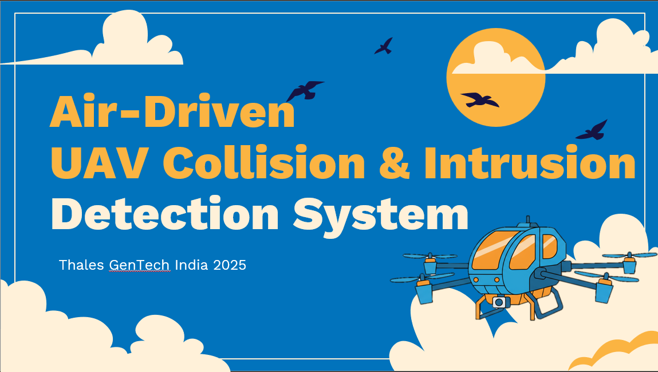
Conclusion
This system improves UAV safety using AI
Collision risks can be detected early
Intrusion threats can be flagged instantly
Ideal for Defence, Aerospace & Airspace Security
Lightweight, scalable, and future-ready
Tagline: “Safer Skies Through Intelligent Automation”

Slide 13
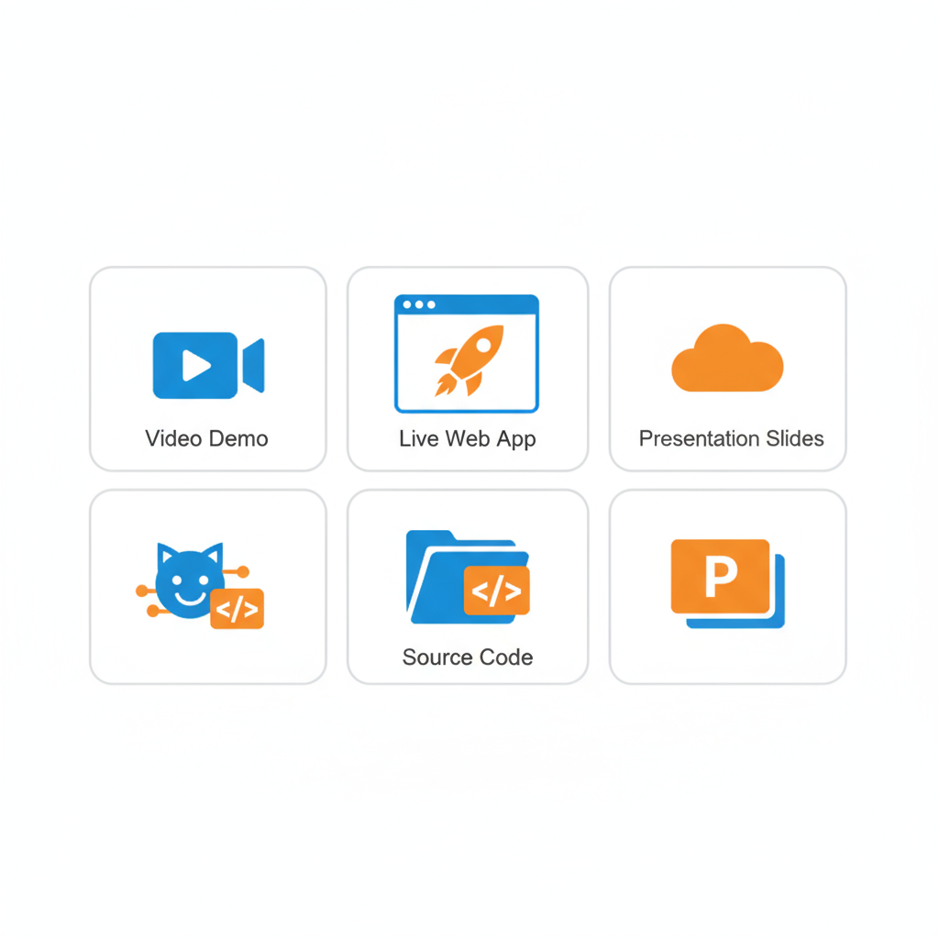
Prototype Demonstration
👉 Demo Video
👉 Live Demo
👉 GitHub Repository
👉 Source Code

Slide 14

Thanks!
“Thank you for reviewing the project. Your feedback and guidance are valuable!”
Do you have any questions?
grakesh2605@gmail.com
+91 901 454 5319
Linkedin

